Slide 1
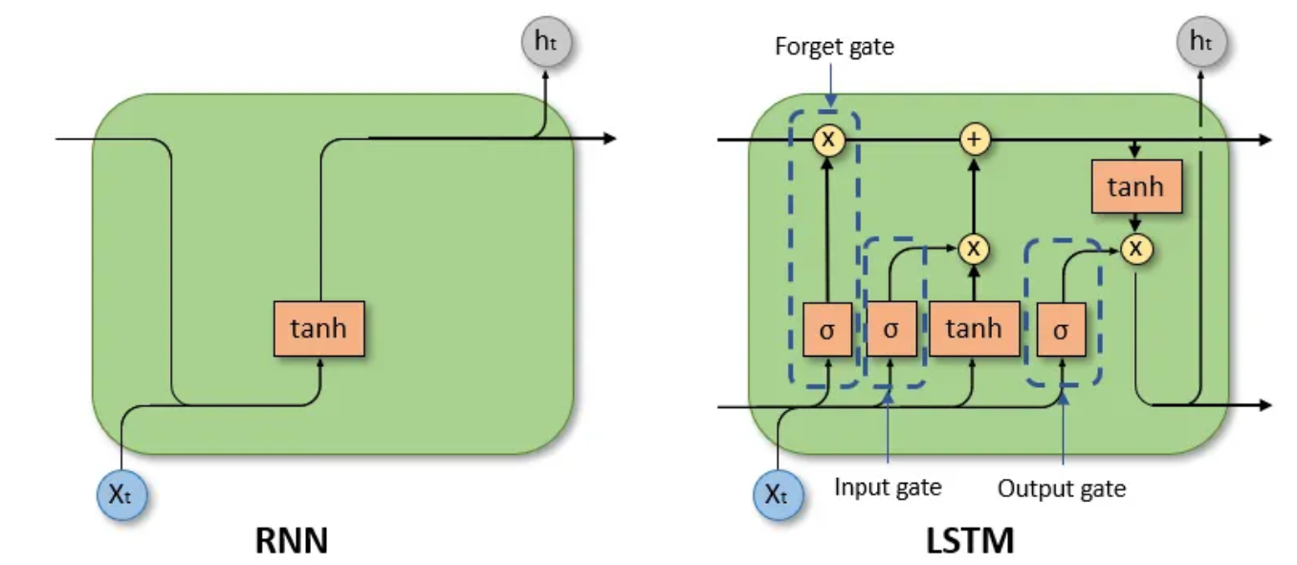
LTSM resolve the vanishing gradient by
1- Forget irrelevant information
2-Add/update new information
3-Pass updated information

Slide 2
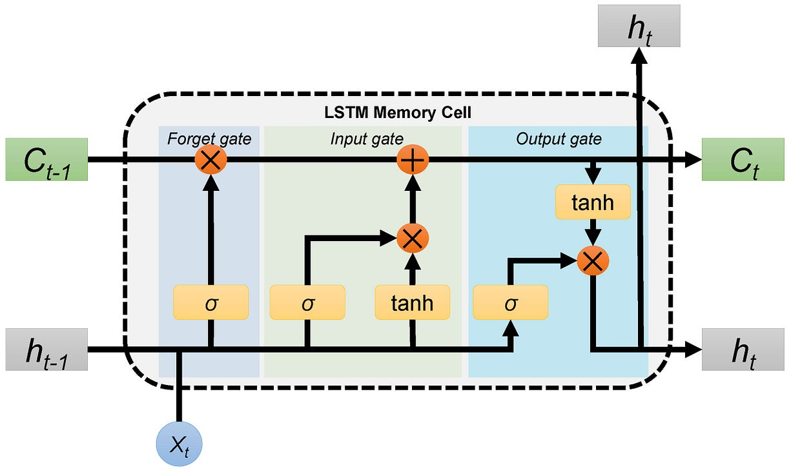
C ➔Long term memory
h ➔Short term memory

Slide 3
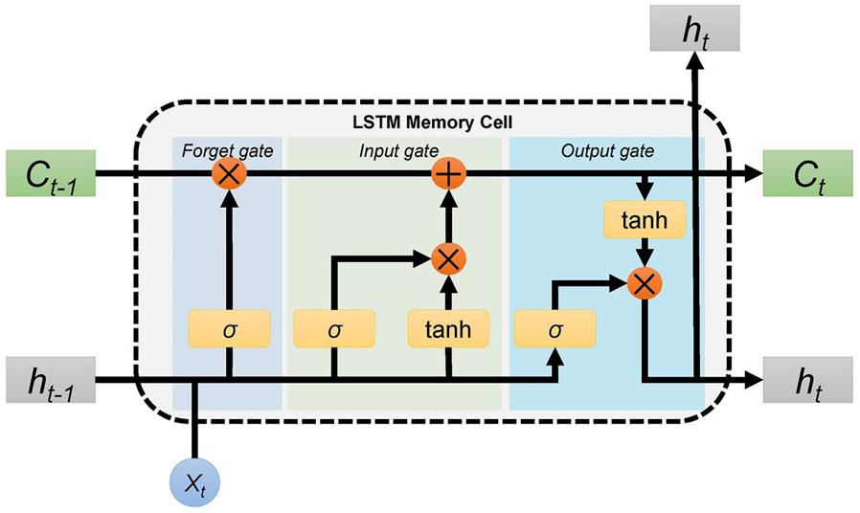
Forget gate f ➔Short term memory
0: forget everything
1: forget nothing

Slide 4
Updating the cell state
New C
New information(output of tanh -1,1
Input gate i

Slide 5
hidden state is a function of Long term memory (Ct)
Output gate o

Slide 6
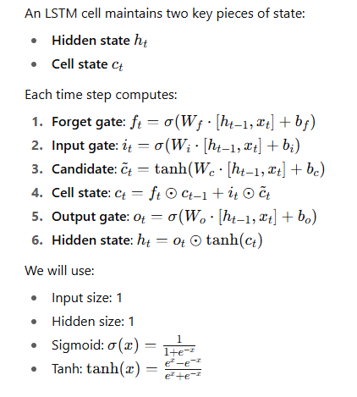

Slide 7
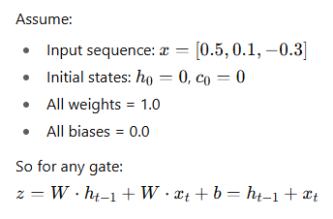

Slide 8
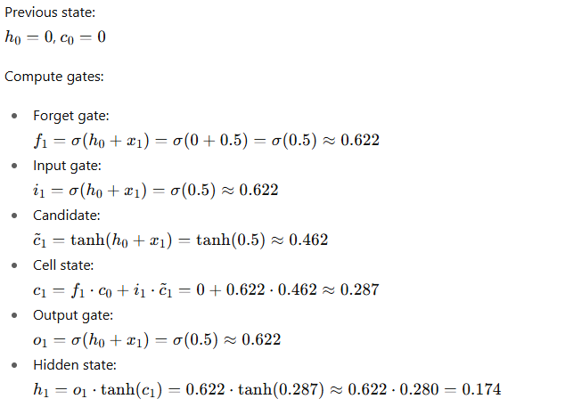
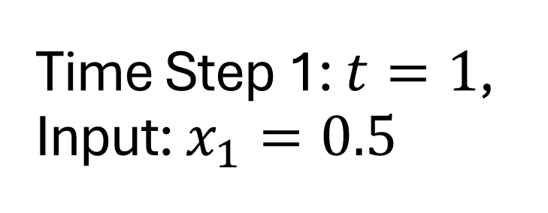
Time Step 1: $t=1$, Input: $x_{1}=0.5$

Slide 9
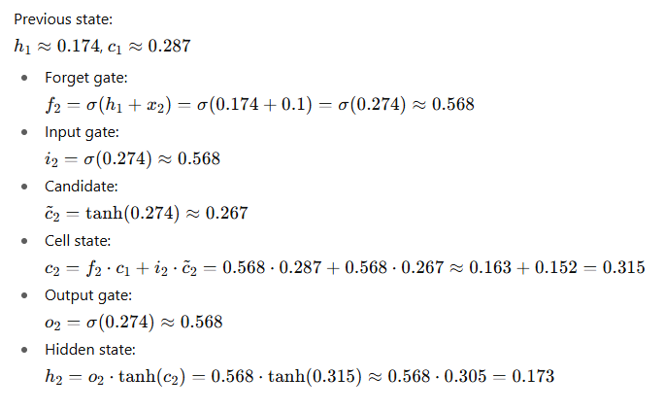
Time Step 2: 𝑡=2t=2, Input: 𝑥2=0.1x2 ​=0.1

Slide 10
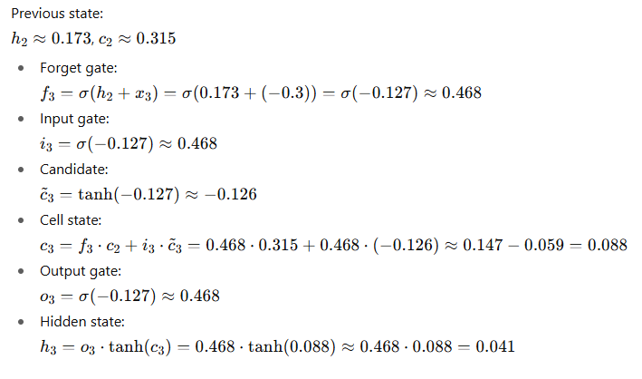
Time Step 3: 𝑡=3t=3, Input: 𝑥3=−0.3x3 ​=−0.3

Slide 11
Summary table
Time | Input ( x_t ) | Forget ( f_t ) | Input ( i_t ) | Candidate ( \tilde{c}_t ) | Cell ( c_t ) | Output ( o_t ) | Hidden ( h_t )
1 | 0.5 | 0.622 | 0.622 | 0.462 | 0.287 | 0.622 | 0.174
2 | 0.1 | 0.568 | 0.568 | 0.267 | 0.315 | 0.568 | 0.173
3 | -0.3 | 0.468 | 0.468 | -0.126 | 0.088 | 0.468 | 0.041

Slide 12
How to build and train an LSTM model for time series forecasting

Slide 13
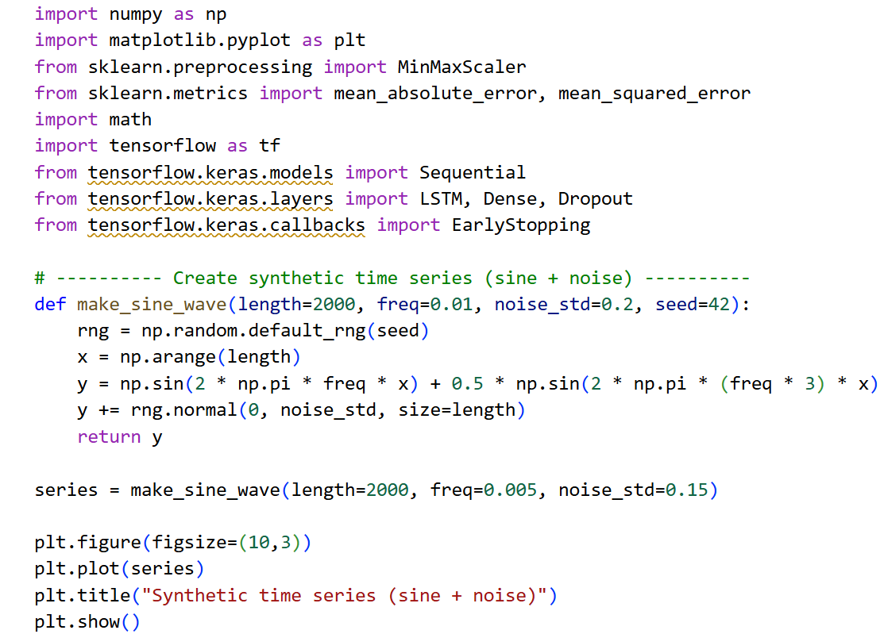
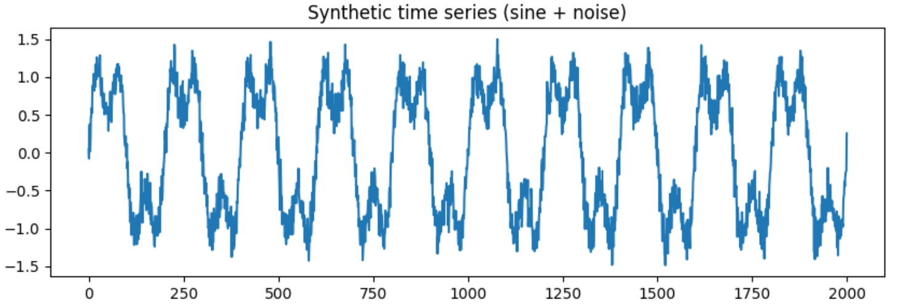
Data generation (sine + noise)

Slide 14
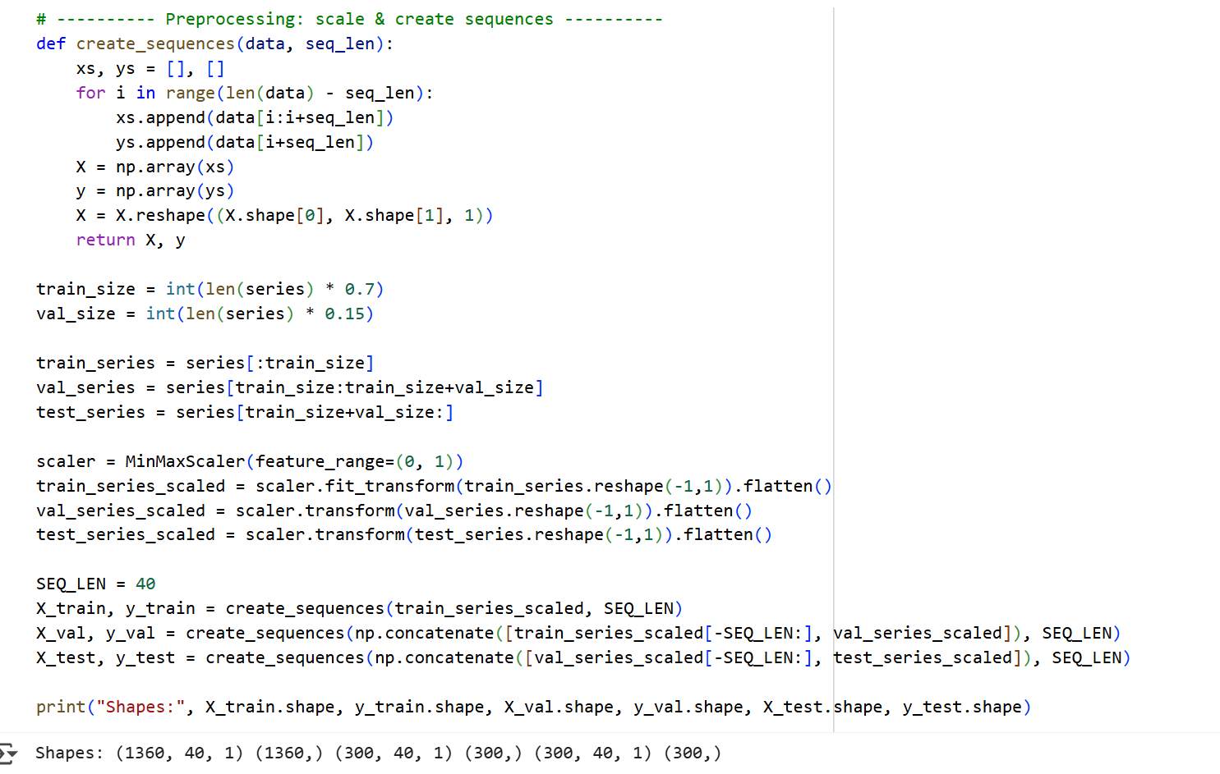
Preprocessing and sequence creation

Slide 15
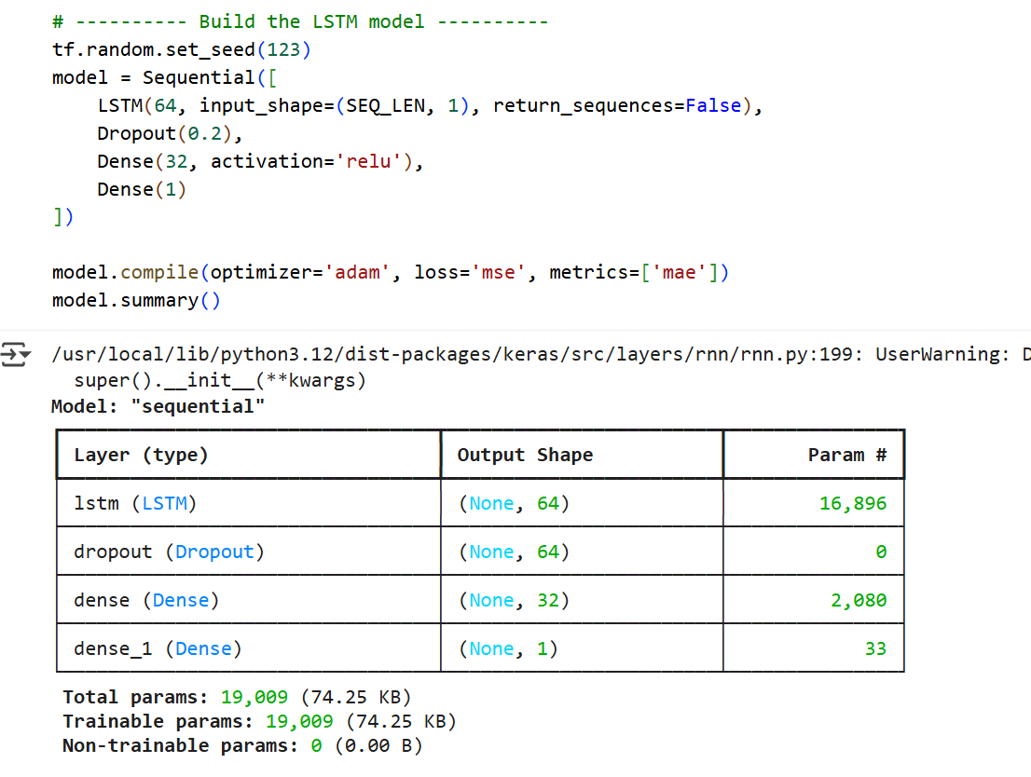
Building and training an LSTM model

Slide 16
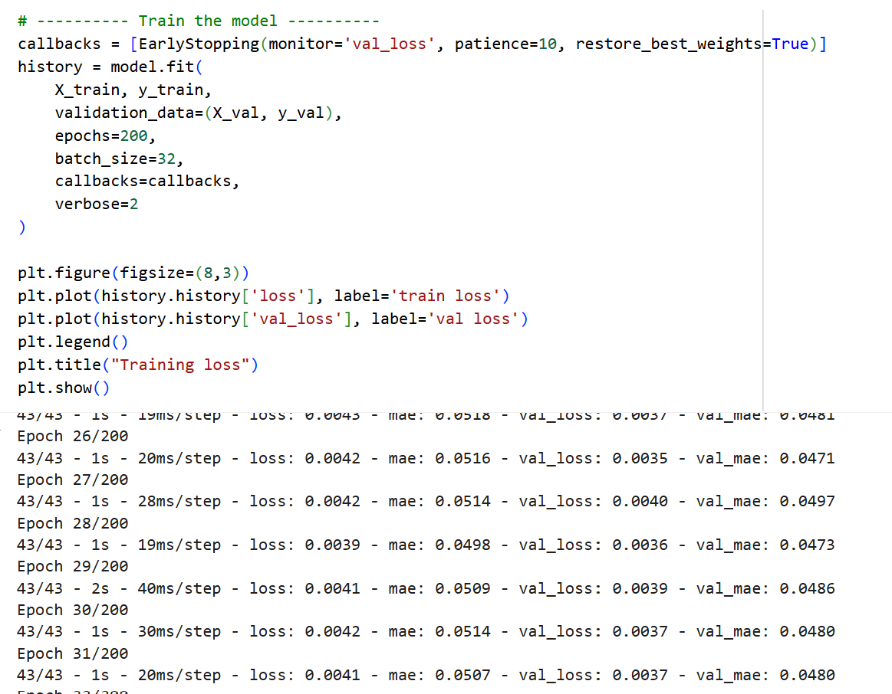
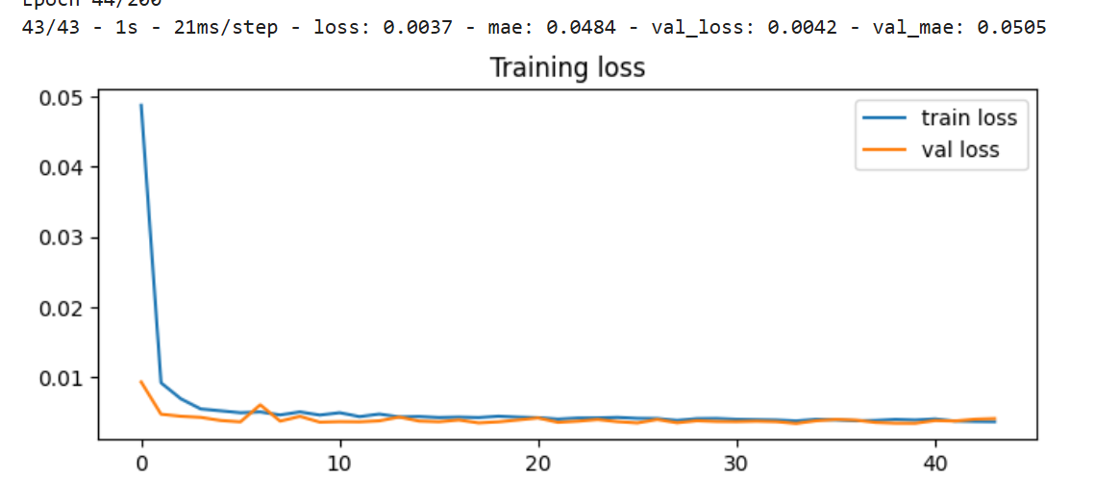
Train the model

Slide 17
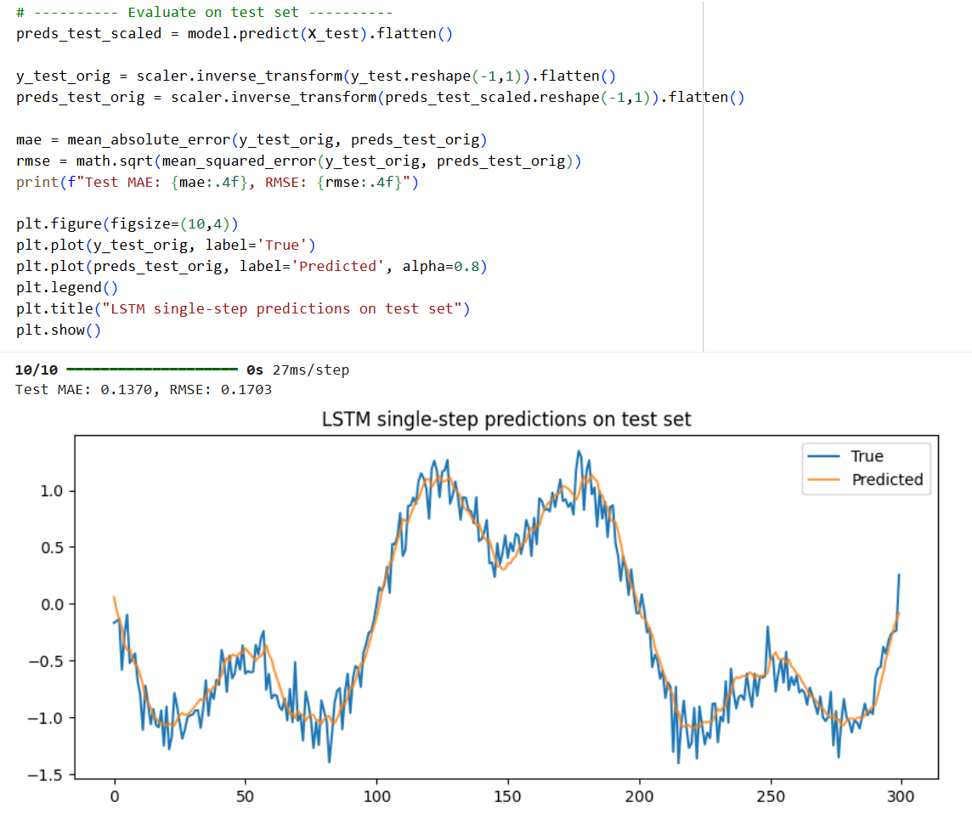

Slide 18
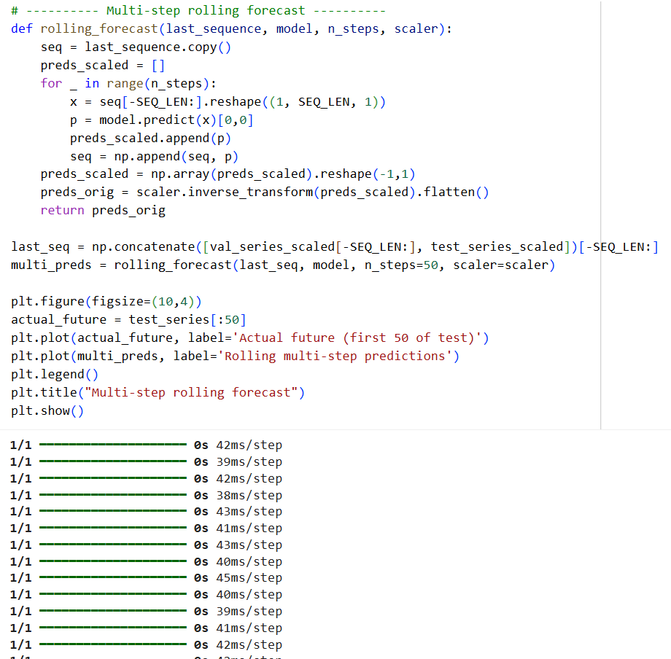
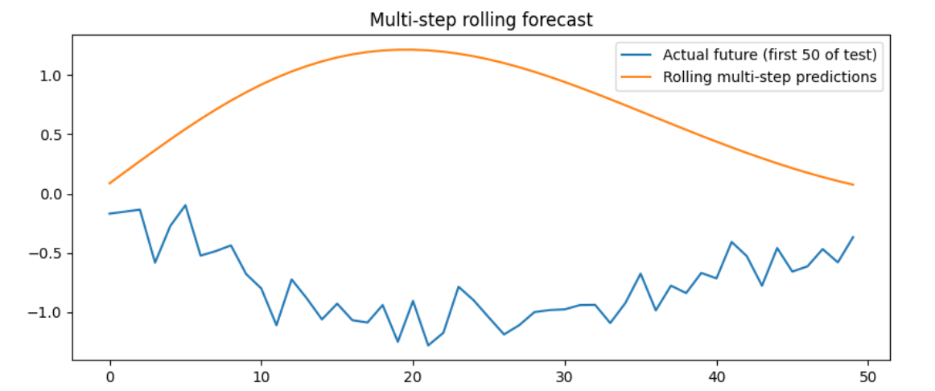

Slide 19
Long Term Memory
New long-term memory
What percentage of the long-term memory to remember
Potential short-term memory
What percentage of the potential memory to remember
Potential long-term memory (input+short)
What percentage of the short-term memory to remember
Short Term Memory
New short term memry

Slide 20
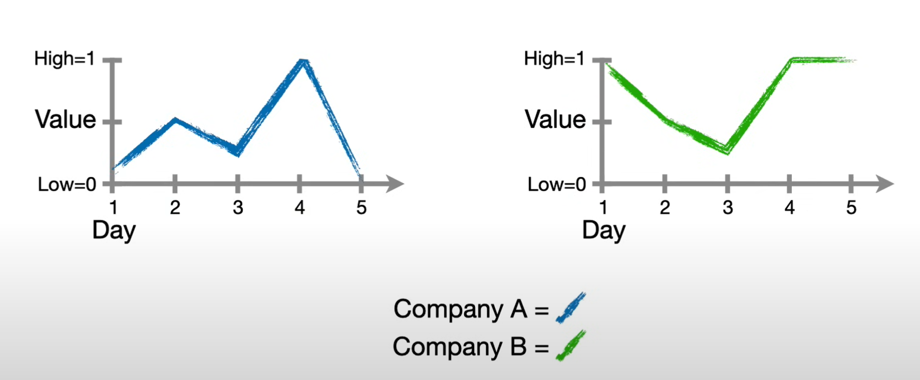
Predict the values of day 5 for both companies A and B based on the values of days 1,2,3,4
 | Company A |  |  |  | Company B
Day | value |  |  | Day | value
1 | 0 |  |  | 1 | 1
2 | 0.5 |  |  | 2 | 0.5
3 | 0.25 |  |  | 3 | 0
4 | 1 |  |  | 4 | 1
5??? | 0??? |  |  | 5??? | 1??

Slide 21


Initial long-term memory
c1 = -0.2
c0 = 0
-0.20
4
4
-0.20
1
0.83
3
2
-0.31
0.65
-0.13
6
f1 = $σ$(1.62)
0.64
i1 = $σ$(0.62)
ć1 = tanh(-0.32)
5
Bf = 1.62
Bi = 0.62
Bc = -0.32
Bo= 0.59
Wf = 2.7
Wi = 2.0
Wc = 1.41
Wo = 4.38
h0 = 0
Uf = 1.63
Ui = 1.65
Uc = 0.94
Uo = -0.19
Initial short
term memory
Input
0(2)+0(1.65)+0.62= 0.62
sig(0.62) = 0.65
c1= 0(0.83) + 0.65(-0.31) = -0.2
c1 = -0.2
h1 = -0.13
0(2.7) + 0(1.63) + 1.62 = 1.62
Sig(1.62) =0.83
2
4
1
0(1.41)+0(0.94)-0.32=-0.32
Tanh(-0.32) = -0.3106
0(-0.19) + 0(4.38) + 0.59 = 0.59
sig(0.59) = 0.64
0.64(tanh(-0.2)) = -0.13
h1 = -0.13
3
5
6

Slide 22
Initial long-term memory
c1 = -0.2
c0 = 0
-0.20
4
4
-0.20
1
0.83
3
2
-0.31
0.65
-0.13
6
f1 = $σ$(1.62)
0.64
i1 = $σ$(0.62)
ć1 = tanh(-0.32)
5
Bf = 1.62
Bi = 0.62
Bc = -0.32
Bo= 0.59
Wf = 2.7
Wi = 2.0
Wc = 1.41
Wo = 4.38
h0 = 0
Uf = 1.63
Ui = 1.65
Uc = 0.94
Uo = -0.19
Initial short
term memory
Input
0(2)+0(1.65)+0.62=-0.62
sig(0.62) = 0.65
c1= 0(0.83) + 0.65(-0.31) = -0.2
c1 = -0.2
h1 = -0.13
0(2.7) + 0(1.63) + 1.62 = 1.62
Sig(1.62) =0.83
2
4
1
0(1.41)+0(0.94)-0.32=-0.32
Tanh(-0.32) = -0.3106
0(-0.19) + 0(4.38) + 0.59 = 0.59
sig(0.59) = 0.64
0.64(tanh(-0.2)) = -0.13
h1 = -0.13
3
5
6

Slide 23
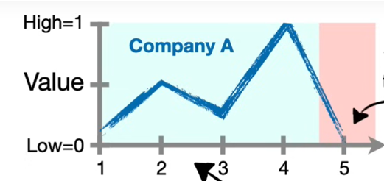
Initial long-term memory
Updated long term memory
0
-0.2
0
-0.13
Initial short
term memory
Updated short term memory
Day 1 =0
Day 2 =0.5

Slide 24
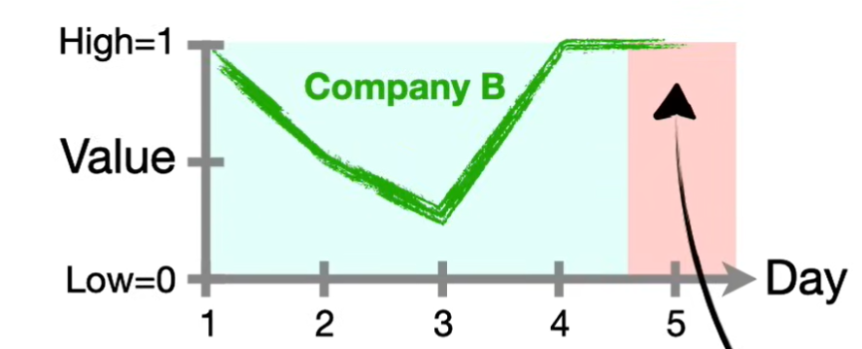
Initial long-term memory
Updated long term memory
0
0.5
0
-.3
Initial short
term memory
Updated short term memory
Day 1 =1
Day 2 =0.5

